Slide 1
Building chat bot
Nut Sornchumni
Software Engineer - Frontend

Slide 2
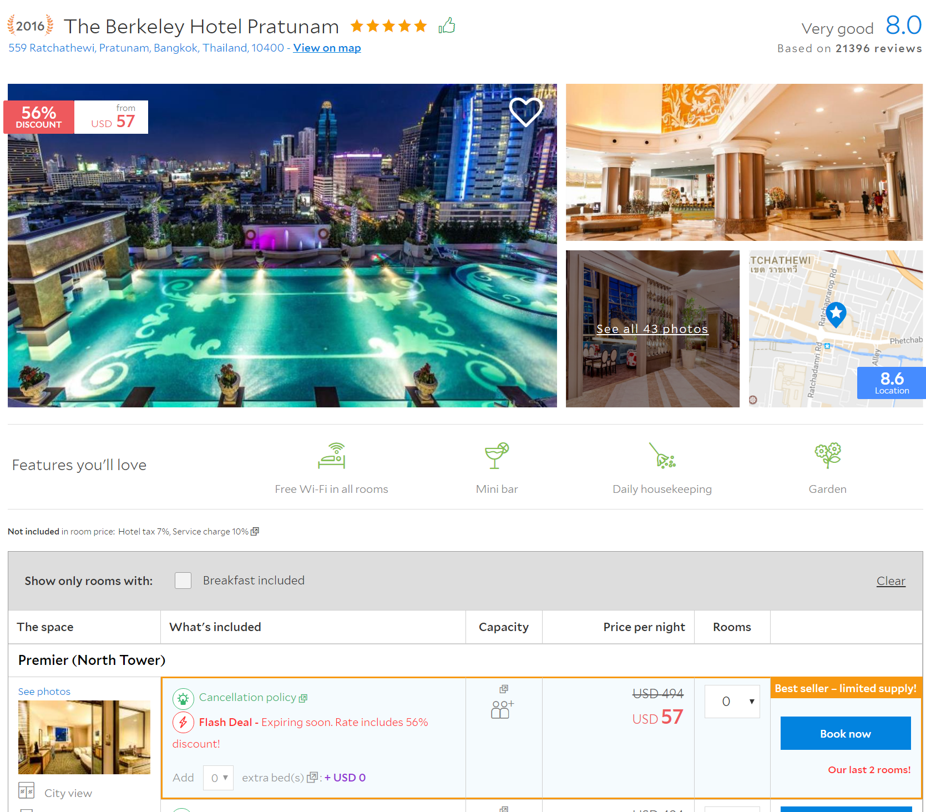
Who am I
Engineer working on Agoda’s website (www.agoda.com)
I have been working on Property page for almost two years.
Now working on another Agoda’s undisclosed project ☺
Love to code and all kind of coding competitions.
Notes:
Short intro about myself
Frontend @ Agoda
Side project
etc

Slide 3
What do you think of when talking about ‘bot’
Game’s AI
Starcraft? Ragnarok?
More intelligent..?
Alpha GO
Siri
Jarvis
Alexa
Or a super classic chatbot (at least for Thais ☺) → Simsimi
Notes:
Talking about the word “bot”.
what do we usually think of when talking about bot?
Is it required a conversational ability as same as human or just response to your need?

Slide 4
The bot
Every bots share the same aspect:
Bot’s interaction with the world
What’s the “action/feedback”
Input/output (Interaction with the world)
Text message
Image/video
Voice
Processing data, the bot’s brain
Understanding the context
Complicate actions
WORLD
BOT
Notes:
Bot have 2 parts:
Interface with the world
Brain, processing incoming data, make a suitable response
Bot can do anything just limited by your imagination ☺

Slide 5
The bot framework
There are many bot frameworks to get you start with,
Microsoft bot framework
Available in C#/Node.js
NodeJS botkit
And others
Notes:
Framework that you can use to start building bot very quickly
Microsoft has variety of add-ons to plug into your bot.

Slide 6
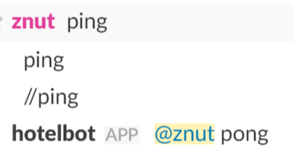
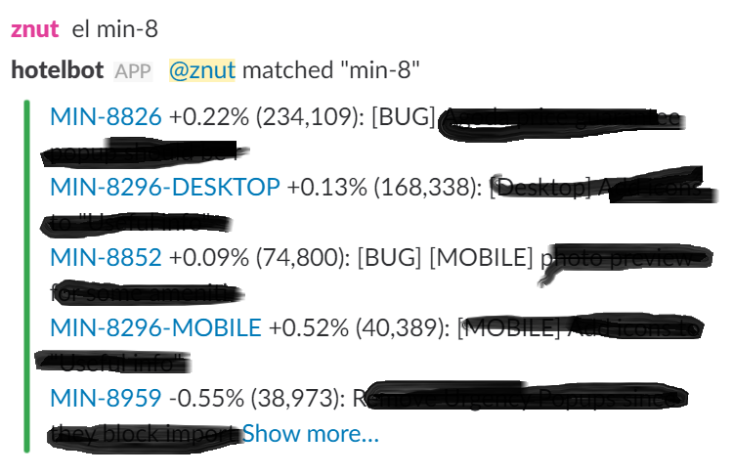
About @hotelbot
Used to interface with HipChat, now on Slack
React to message with predefined “word”
Main functionality: check A/B test data
Built from scratch (except slack-api-client) in Python
Why built everything myself?
Good way to learn things
Fun
Just want to do it :D

Slide 7
About @hotelbot
Messaging driver
Abstraction for sending/receiving message
Easily add new way to interact with the world
Bot-Core
Handle incoming message
Also handle replying the message
Tokenize message and route to responsible module
Processing modules
Separating each module responsibility
Easy to add command when writing new module
Only focus on how to react to the command
The world (is just Slack!)
driver
Core
module
module
module

Slide 8
Interface with Slack API
Slack provided several ways,
Web API (REST)
Easy and familiar. Old school REST API call
Have disadvantages of polling
Events API
Event pushed from Slack to you.
Need to expose webservice/bot to be accessible by the internet.
Real Time Messaging (RTM)
WebSocket is cool ☺
No need to be exposed to the public internet

Slide 9
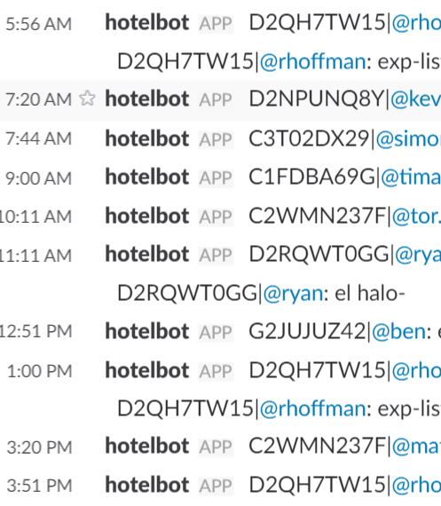

@hotelbot in action
Starting from my self-interests, solving my own problem.
Used privately first in my team.
Made checking A/B test data easily.
Interesting fact
60-70 commands sent to bot
~20 unique users per day
@hotelbot has been live for more than 1 year!
And words from my biggest client
Notes:
You may wonder why A/B test data matter.
At Agoda we take data seriously, we make a decision based on the data and A/B testing, as we call it “experimenting”, is one way that give us a lot of inside data.
The people here frequently look at these data and thinking hard what should we do next.
Lot of time we want to see the data, the conventional way is to open the company’s laptop, VPN into the company’s network, open back office, and find the data.
It is not very convenience if you are doing this on every weekends and sometimes you also not home, maybe on the business trip or vacation.
For @hotelbot, you can just pick your iphone and text exp TEST-1234 then your result is there.

Slide 10
@hotelbot extension
Agoda’s hotel reservation
Agoda’s customer service
Server monitoring/reporting
Report basic hardware or application stat
More advance potential problem detection
And more up to your imagination ☺

Slide 11
What did I learn from bot project
Learn Python3
Build something bigger with python
Slack API, web socket
Sparked my interest in bot ☺
Potential security risk here
Slack account compromise
If bot actions execute SQL or some serious functionality

Slide 12
Interesting projects related to bot
Conversational
wit.ai
api.ai
luis.ai
Recognition service
Google cloud vision
Amazon voice service
Mark’s Jarvis
Amazon’s Alexa

Slide 13
Thank you!
Find me at
Email: nut.sornchumni@agoda.com
Twitter: @znutcpe
Github: github.com/znut
Notes:
Q&A and showing the code and the bot in action!

